Slide 1
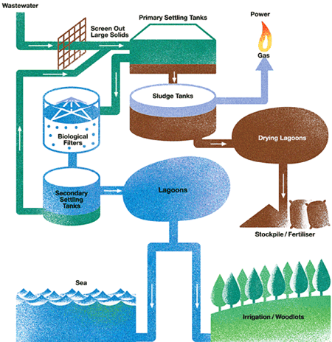

Slide 2
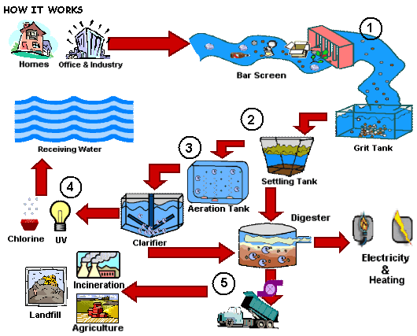

Slide 3
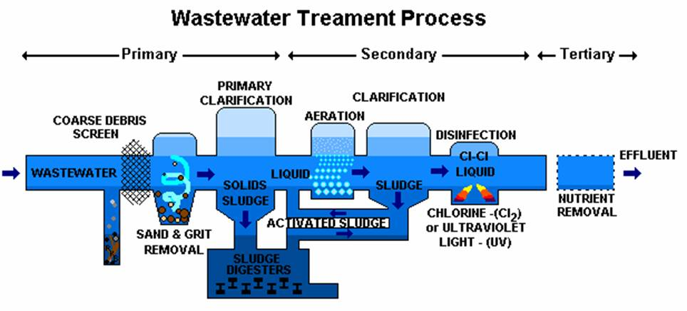

Slide 4
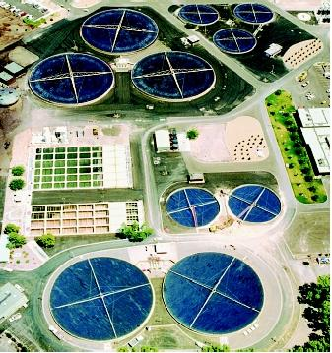

Slide 5
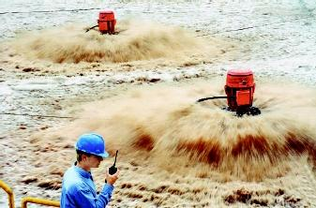

Slide 6
http://www.youtube.com/watch?v=v_aJWYfm4I4
http://www.youtube.com/watch?v=GV-DoisLwm0

